Slide 1
Azure Data factory
Introduction and set up

Slide 2
What is Azure data factory
A fully managed, serverless data integration solution for ingesting,
preparing and transforming all of your data at scale.
Fully managed
Serverless
Data integration service
Data transformation service
Data orchestration service

Slide 3
Azure data factory is
Azure data factory is the cloud based data integration service that enables users to create, schedule, and orchestrate data integration and data transformation workflows. It allows you to integrate data from various sources into a unified data pipeline.

Slide 4
Why to learn Azure Data factory
Cloud based : As a cloud based service, Azure data factory allows you to leverage the scalability and flexibility of the cloud to handle large volumes of the data. It also provides a cost effective solution, you only pay for the resources you consume.
Integration with azure services: Azure data factory integrates with other azure services such as azure synapse Analytics, Azure Data bricks and azure stream analytics.
Enhanced job Prospects: As the demand for cloud based data integration services continues to grow, there is high demand for professional skills in Azure Data factory
Ease of use: User friendly service that does not require users to have extensive programming skills, it provides a graphical interface that allows user to drag and drop data sources, create pipelines and monitor workflows.

Slide 5
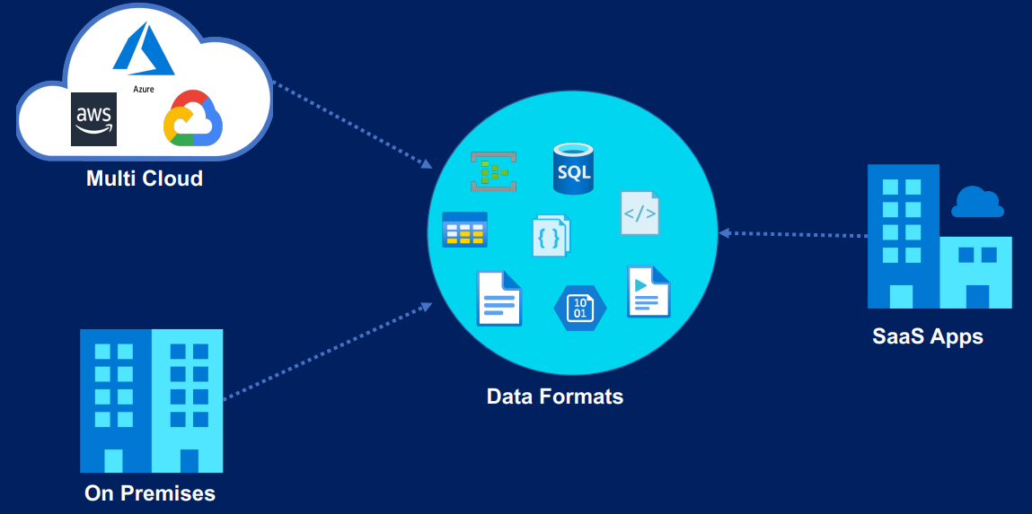
Data sources

Slide 6
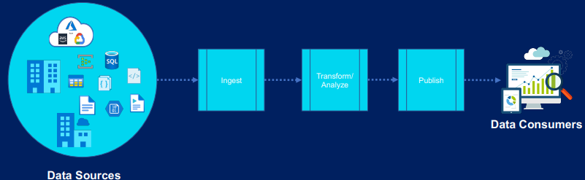
Data problems

Slide 7
Azure data factory is not:
Data Migration tool
Data Streaming service
Suitable for complex data transformation
Data storage service

Slide 8
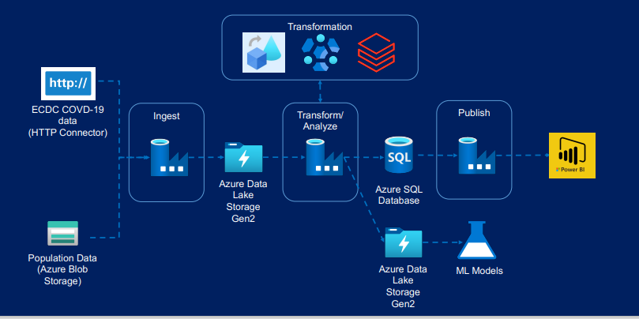
Data processing architecture

Slide 9
Architecture
Ingest
Transform/Analyze
Publish

Slide 10
data available in
Structured
Semi-Structured
Unstructured
JSON
XML
LOG files
NOSQL database
Relational database
Media files like photos, videos, audios
Text files
Log files

Slide 11
ADF file format
Parquet file format
Optimized for large scale data processing and analysis
Columnar based storage
Supports wide range of data types
Advance compression techniques
Preserve the data types via metadata

Slide 12

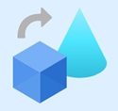


Architecture
Transformation :

Slide 13


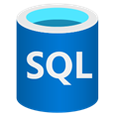
Architecture
Population data (Azure blob Storage)
Azure data Lake storage gen2
Azure SQL Database

Slide 14

Azure database
Azure SQL database
Azure database for MySQL
Azure database for PostgreSQL
Azure database for MariaDB
VM images with Oracle SQL server etc

Slide 15

Azure Storage Account
Blob storage
File storage
Disk storage
Table storage
Queue storage

Slide 16
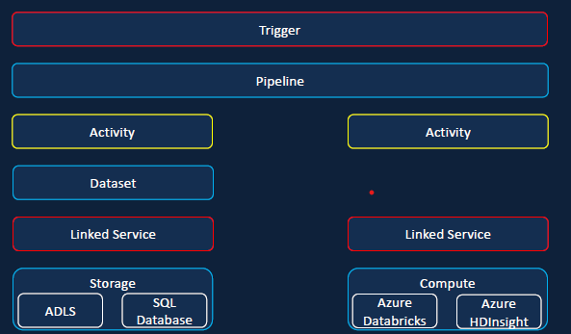
Data Factory component

Slide 17
Environment
set-up

Slide 18
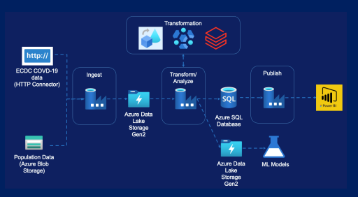

Slide 19
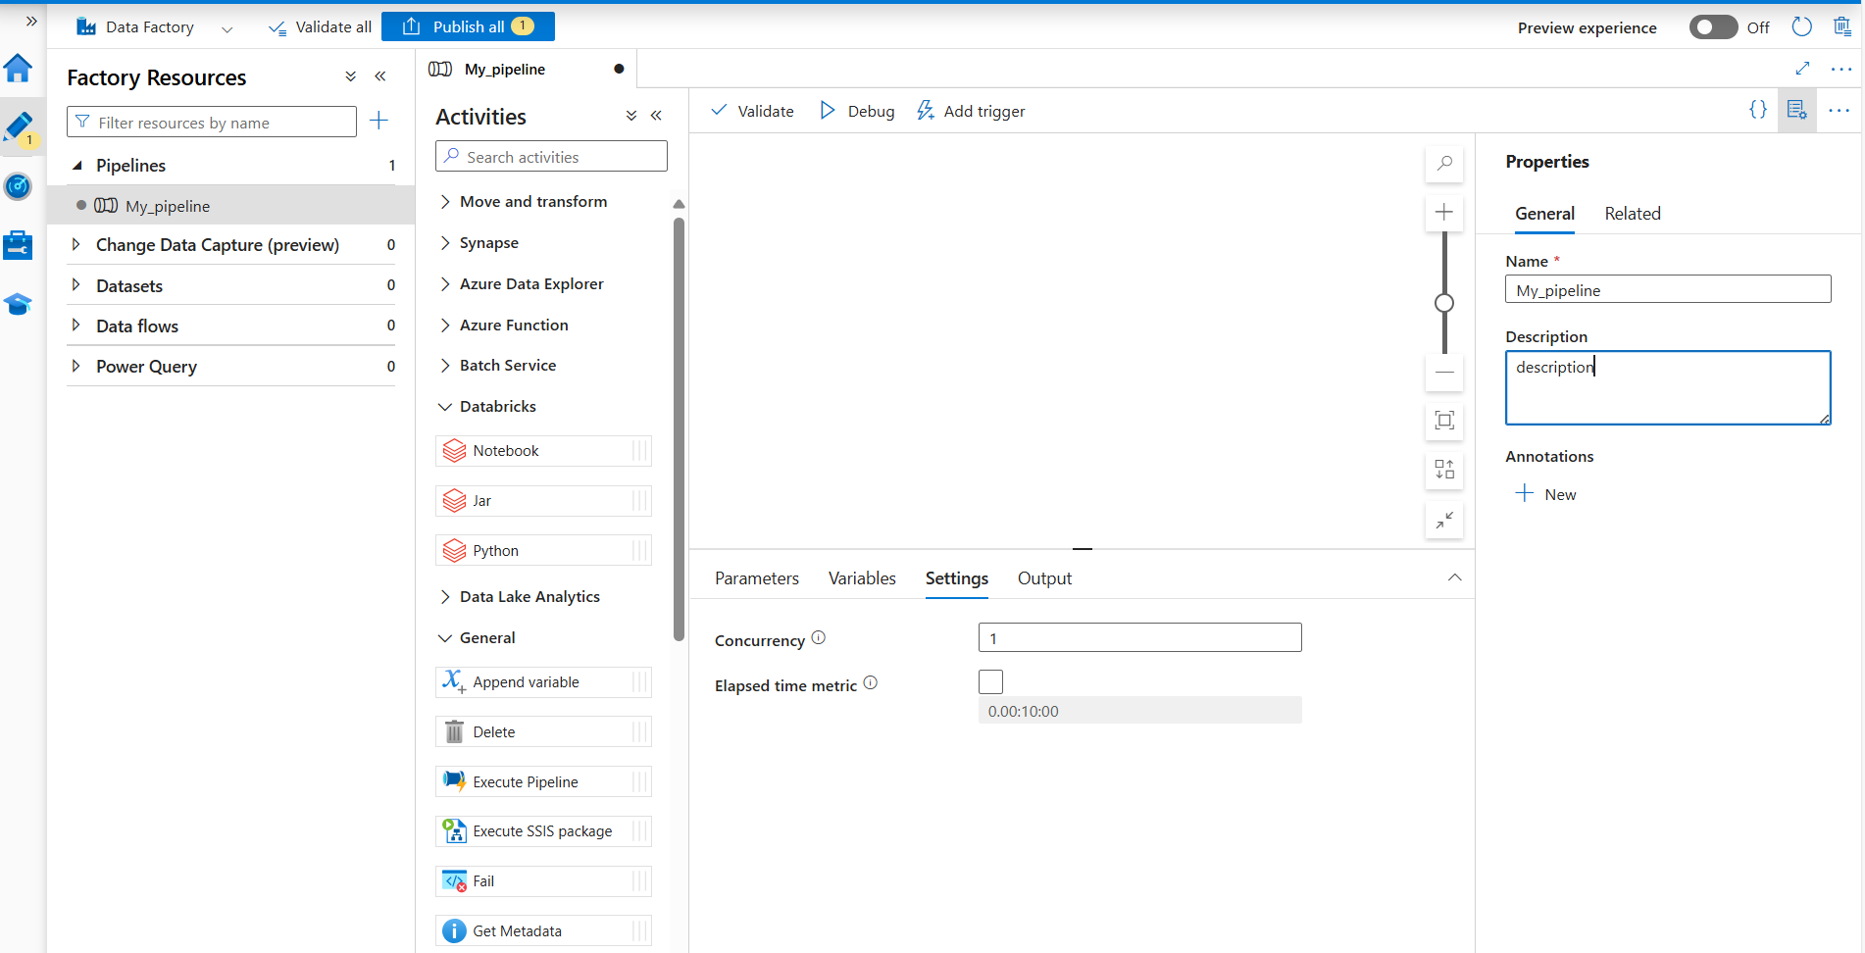
Setting the general properties
Go to Activities -> general
Make changes wherever is highlighted values are.

Slide 20
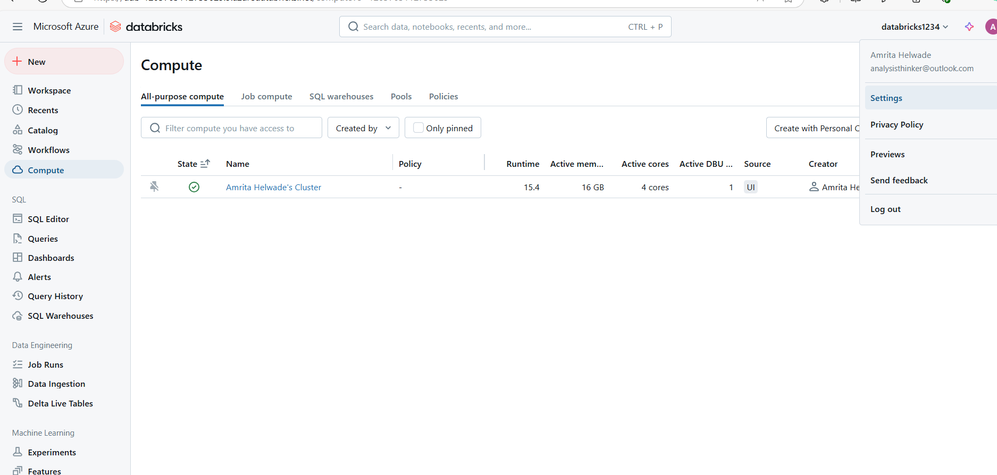
Databricks Notebook
Go to setting in Databricks
Select developer and then move to access token

Slide 21
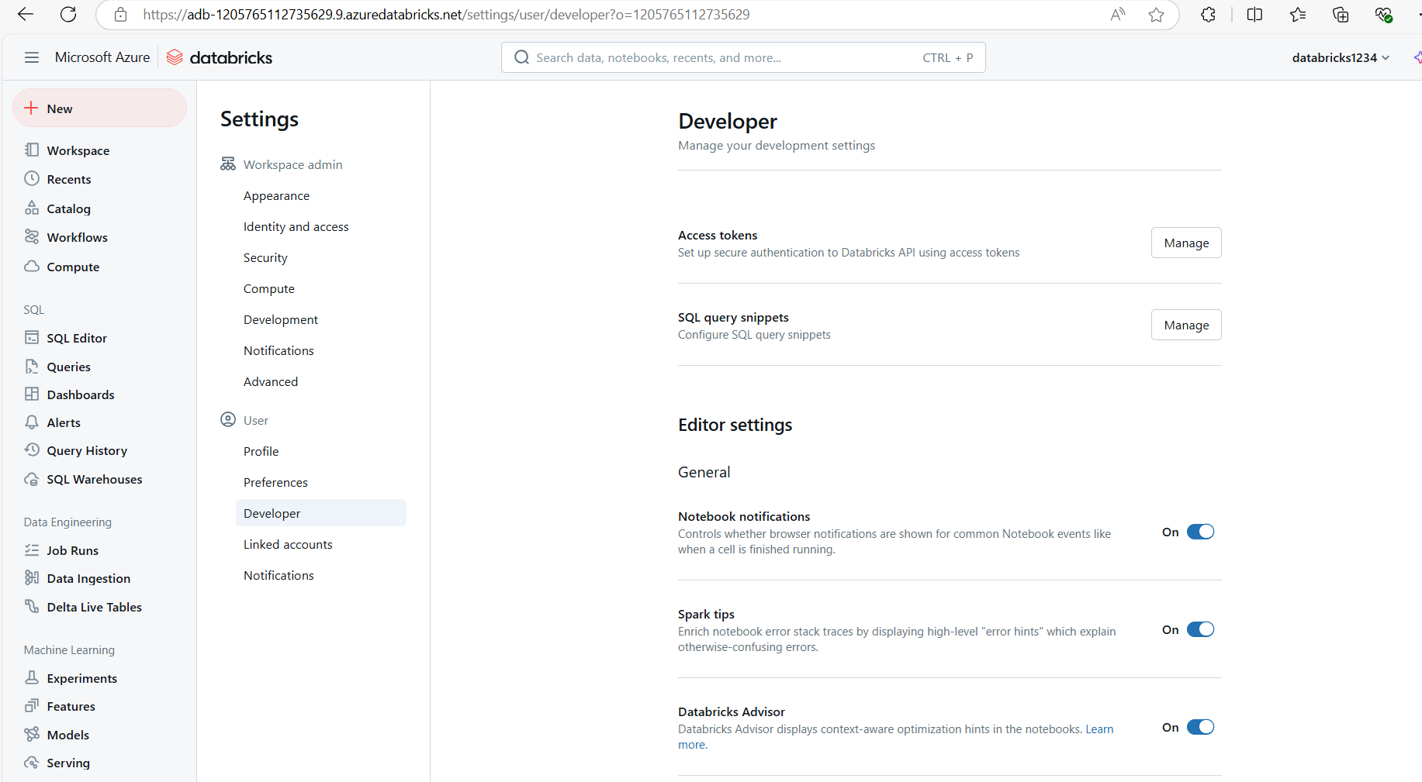

Slide 22
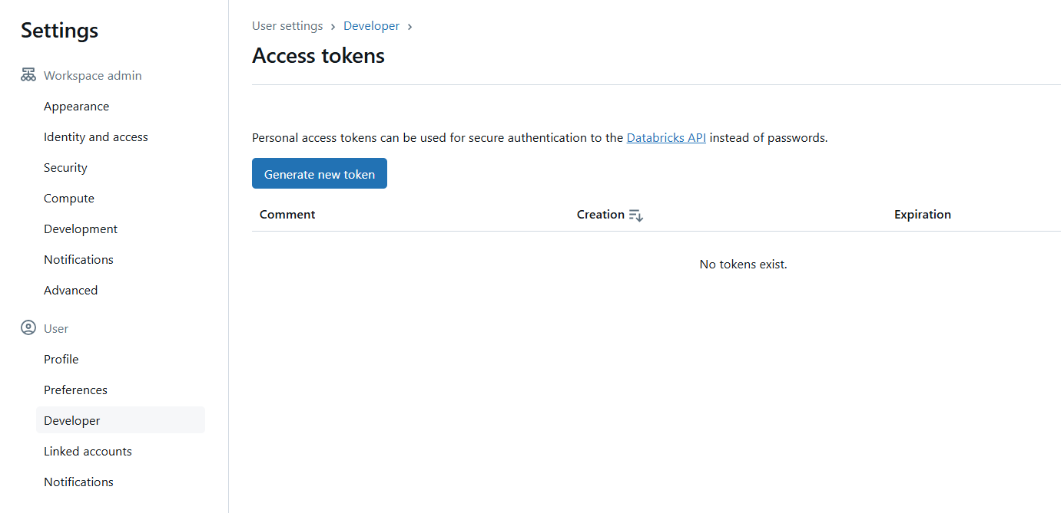
Generate access token

Slide 23
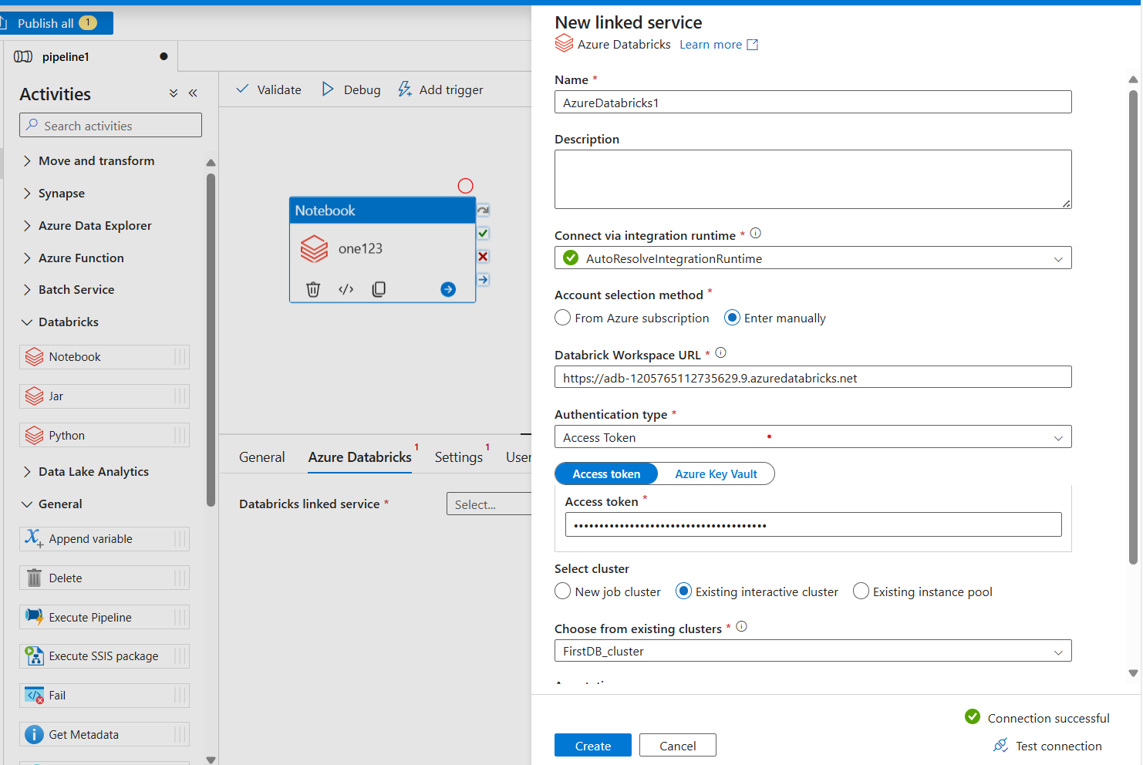
Setting
New link service is created either manually or from azure subscription
For manual:
Copy databricks URL and and pass the access token generated in databricks.
Select the existing cluster and test the connection.
Once the connection successful then create the service.

Slide 24
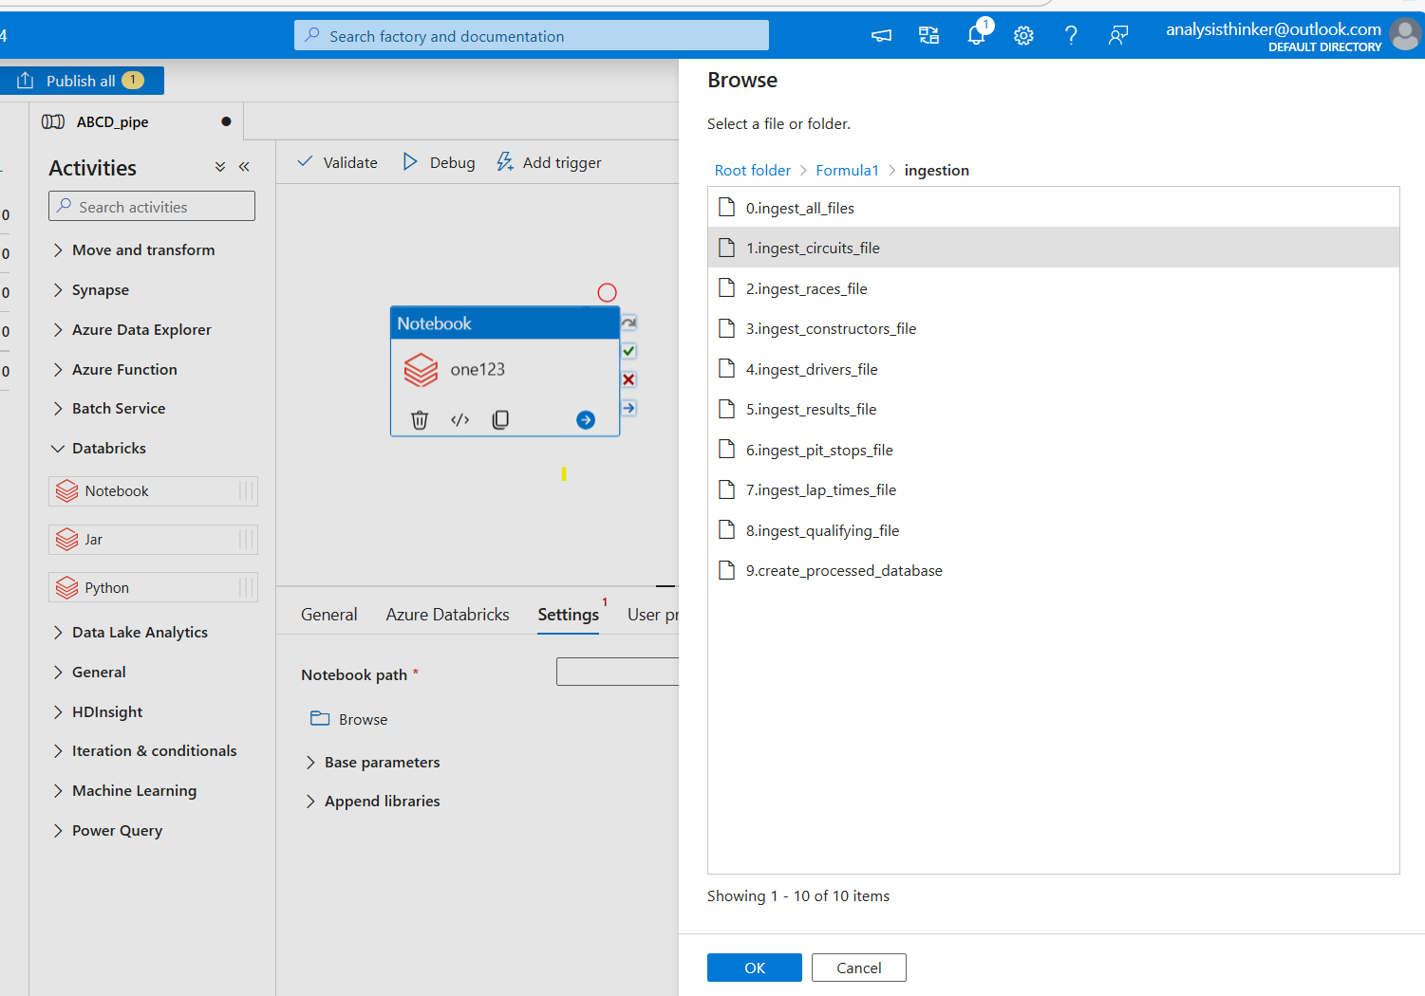
Browsing the path
Go to settings -> browse
Select the file path

Slide 25
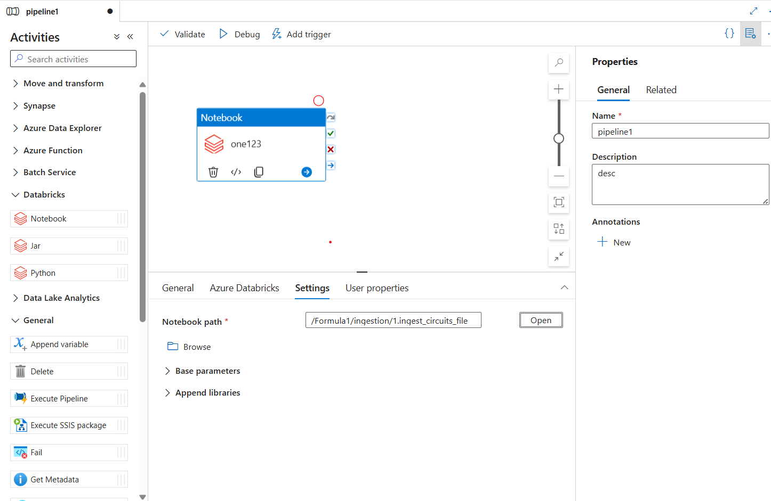
Adding Notebook path
Adding path for execution from the databricks service.
As we have two parameter to pass in the notebook, same has to be shared

Slide 26
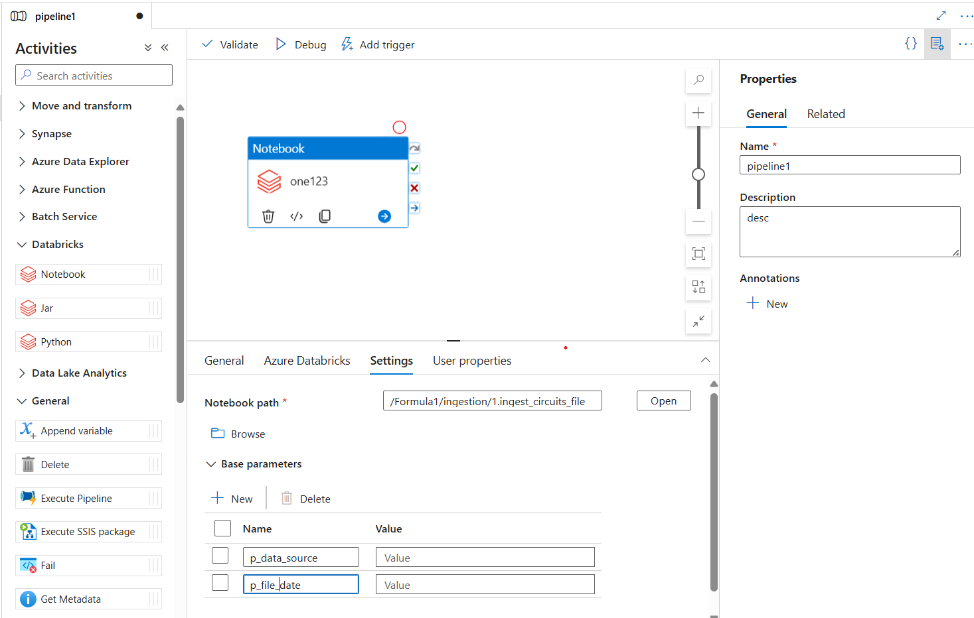

Passing parameter to the file
Click on the Base parameter and add new variable
We may hard code the value for execution
But may not be a suitable solution for pipeline.
Hence another way to click on the pane of databrick and you may see the next window tile.

Slide 27
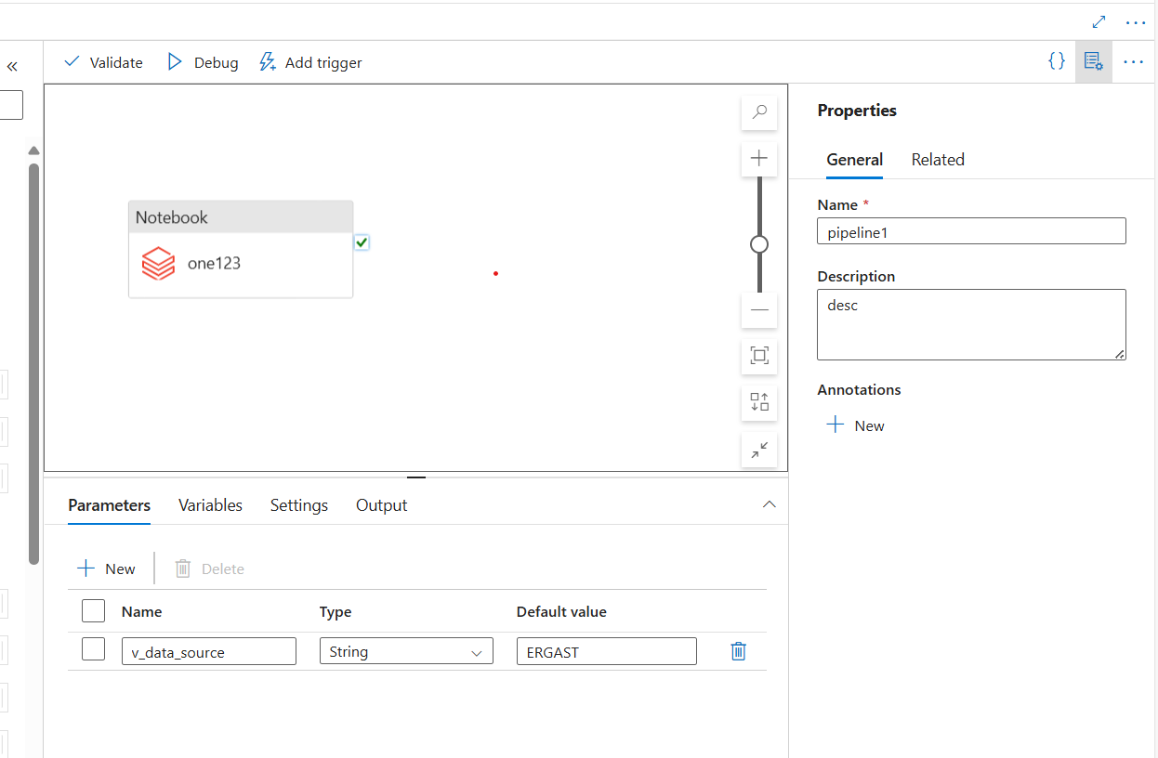
Passing parameters to file
Adding the variable

Slide 28
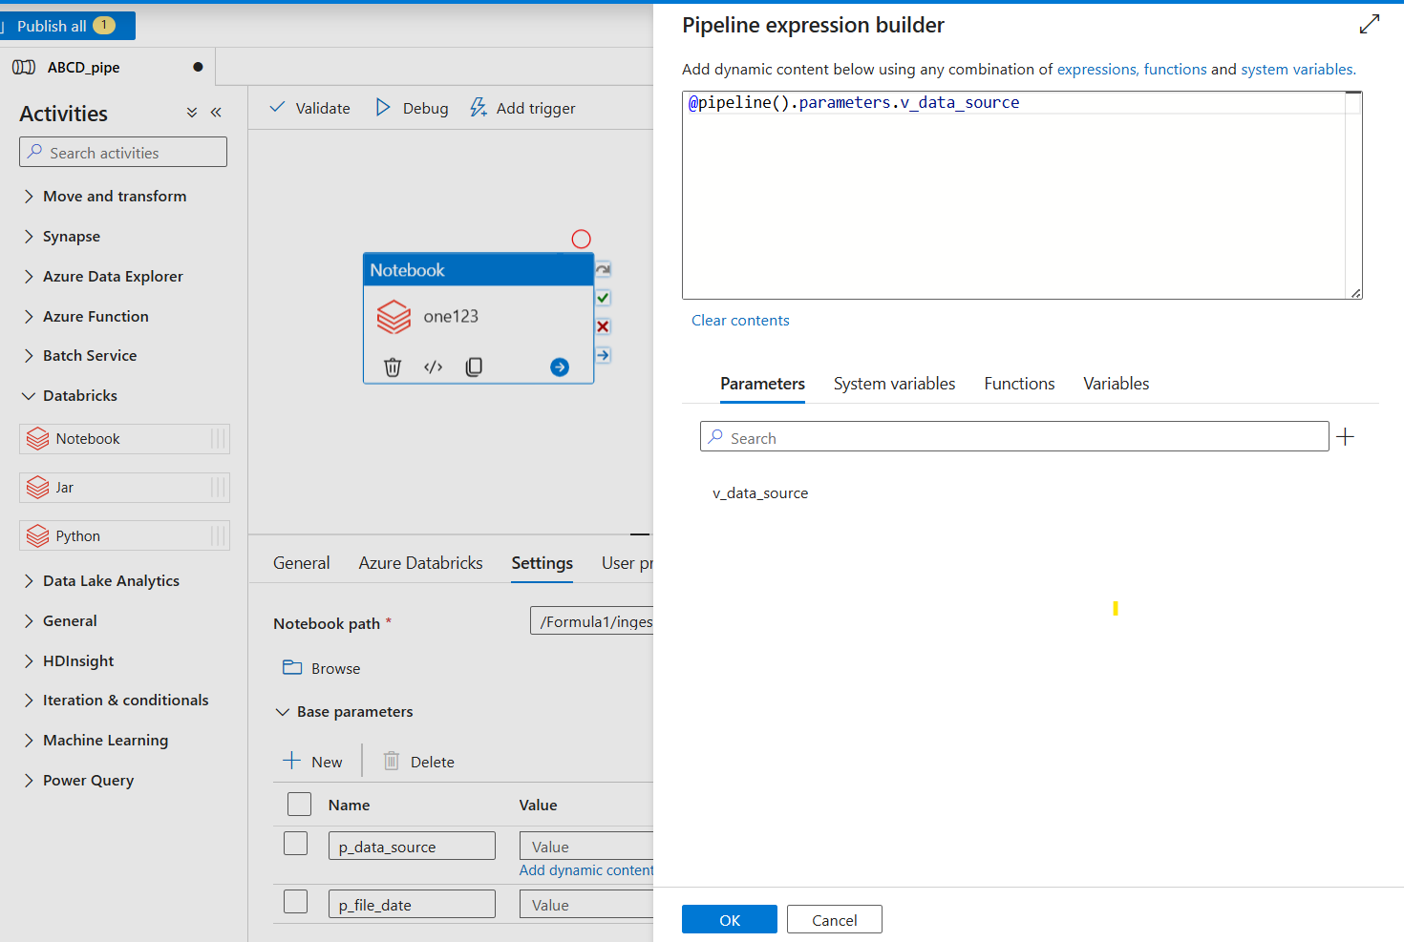
Adding parameters
Adding parameters to base parameter.
Click on Add dynamic values
Pipeline expression builder window is showing valid parameters which is generated before

Slide 29
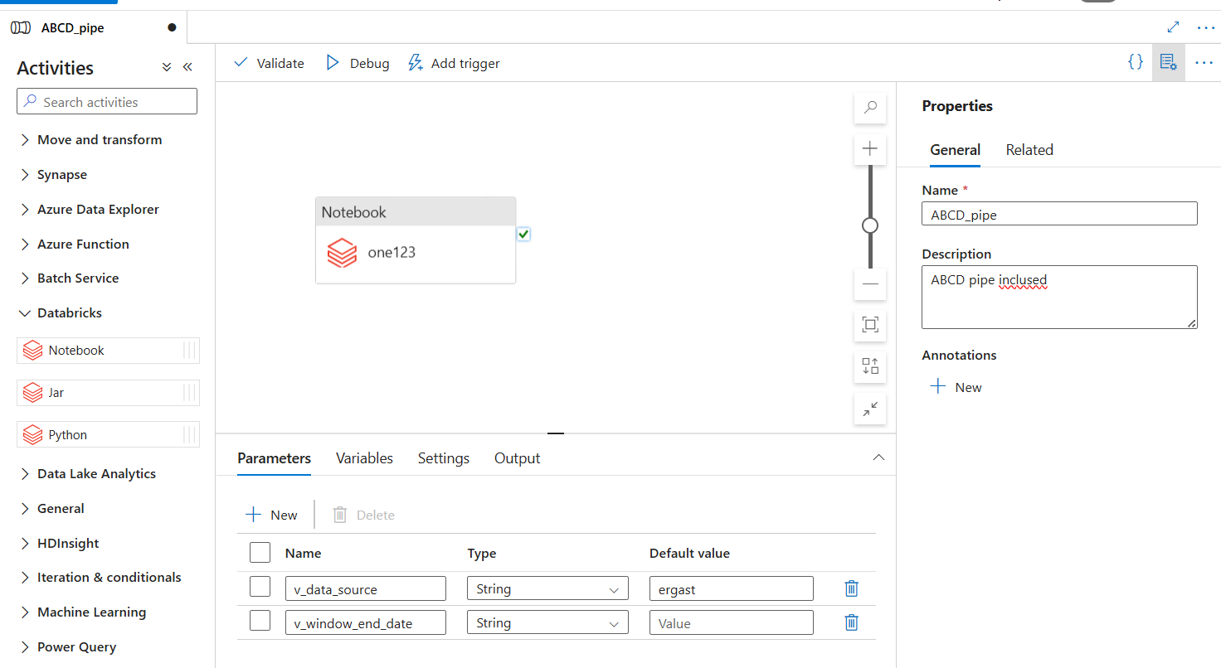
Adding date parameter
Add a new parameter
Go back to notebook parameter and search for the variable v_window_end_date

Slide 30
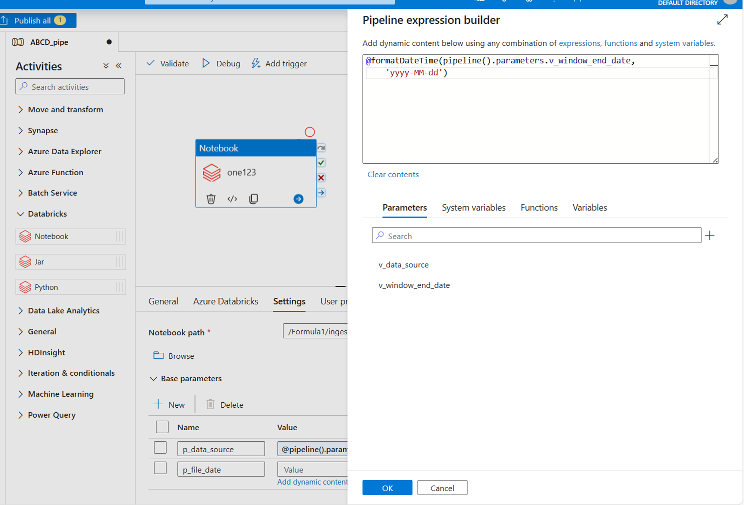
Adding the date parameter
Go to function -> Date function -> formatDateTime
This process create the error as it has no arguments
Now arguments passing is v_window_date and the date format as ‘yyyy-MM-dd’
Once all parameters are passed debug the pipeline

Slide 31
More about date format in Azure data factory
Dates & Timestamps In Azure Data Factory: Parsing, Formatting, Converting - Pipeline & Data Flow | ochzhen.com

Slide 32
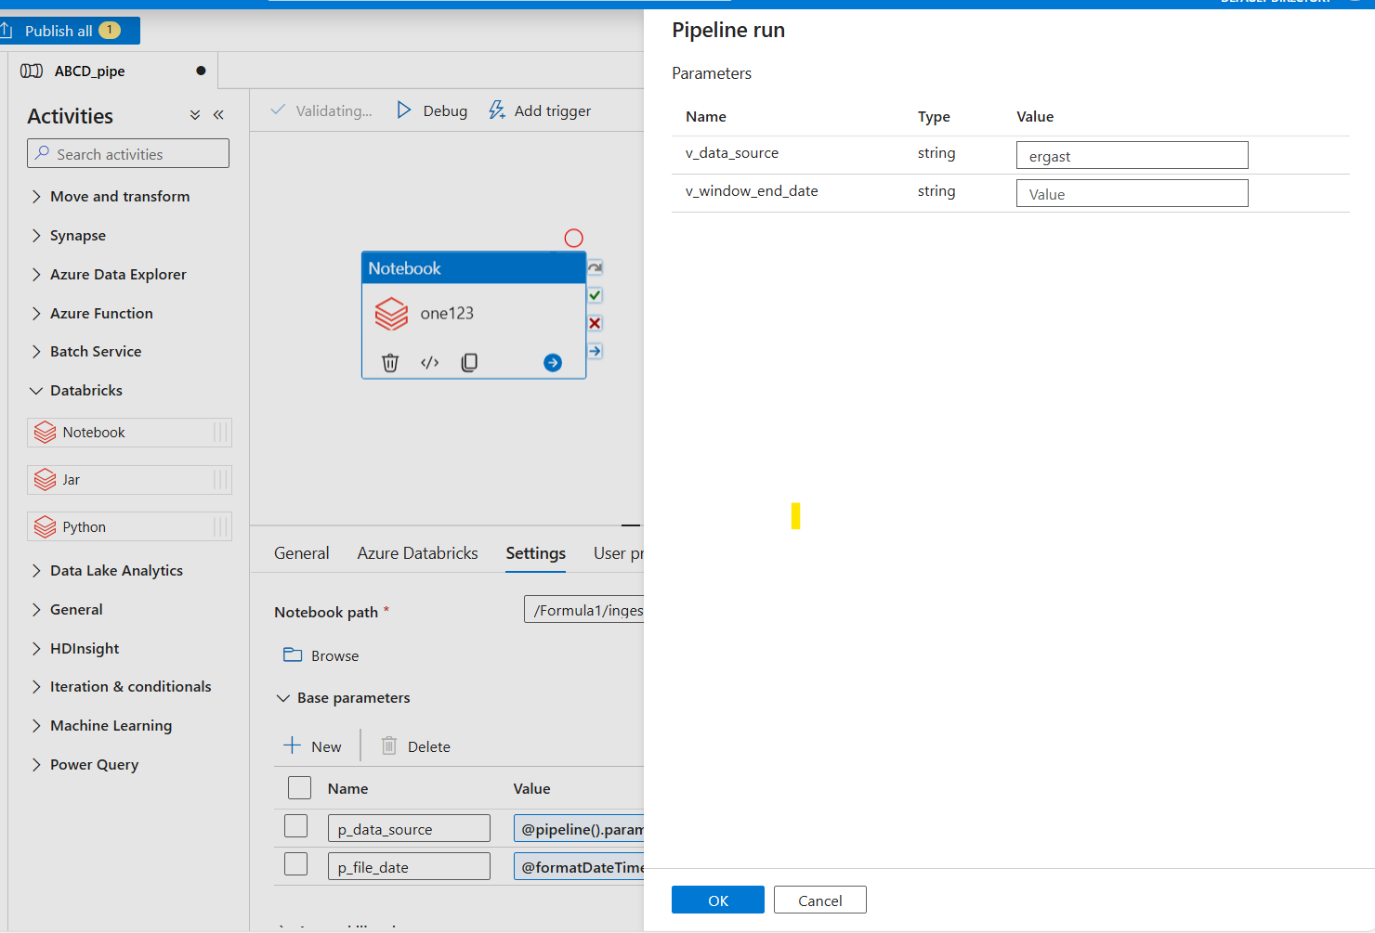
debug
Click on the debug and pass the appropriate values
Once parameters are passed , it may take almost 2-3 min for execution and you may check the process done by clicking on the link.
After debug to make changes permanent click on the publish all.
Without Publish pipeline will not be saved.
Clone the pipeline and do the same process for other files

Slide 33
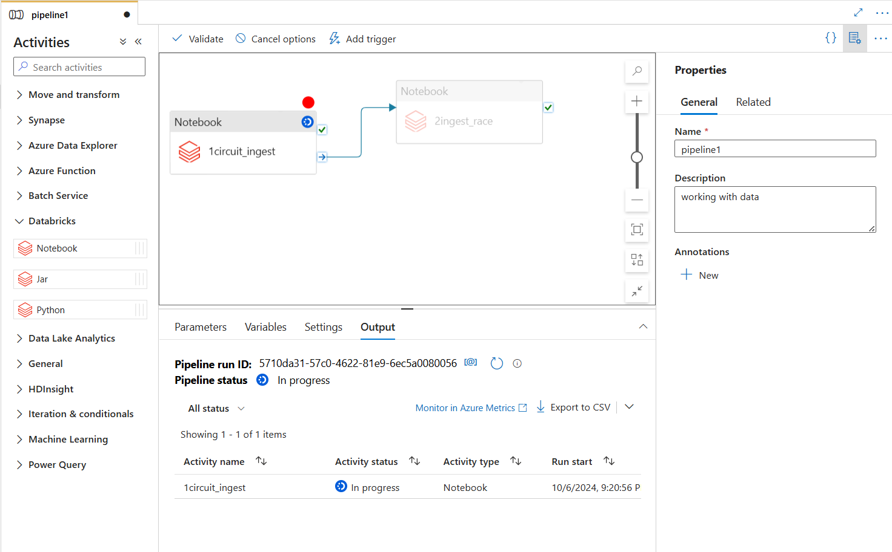
Creating more pipelines
Add new pipe and connect if their execution is sequential.
For parallel execution check if cluster size allocation is sufficient or not.

Slide 34
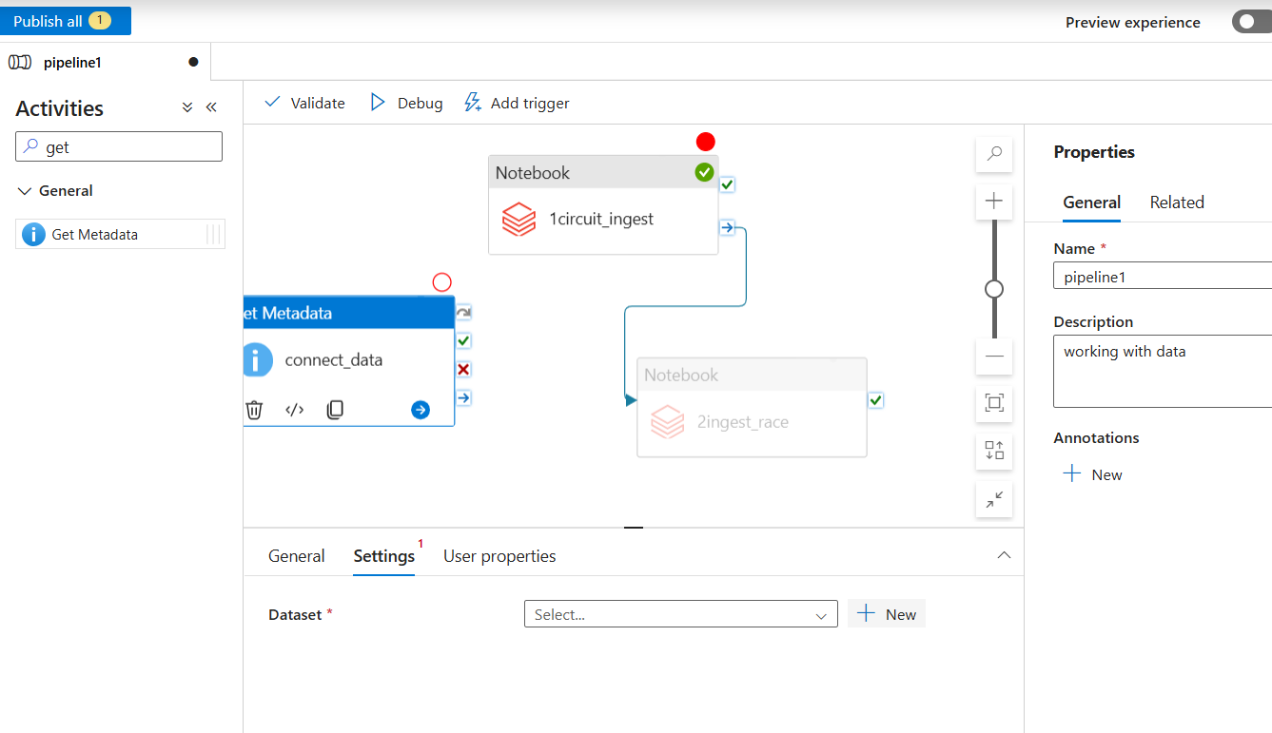
Connecting the storage
Add the get metadata.
Go to settings
Click on the new and add the respective parameters
Select the ADLS gen2 as our data is available there.
Select the proper file but currently there are various files format.
For a first example, select json files.

Slide 35
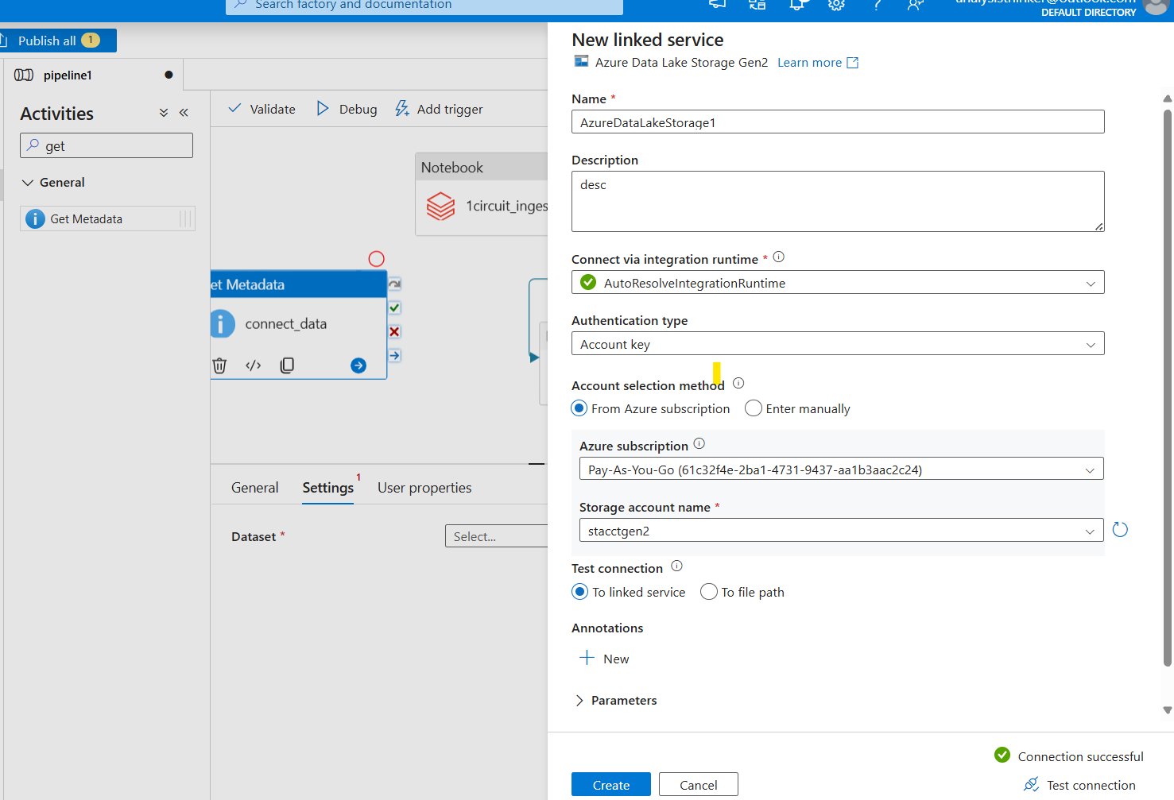
Connecting the storage
Create the new link service.
And pass the proper storage acct name.
Test the connection and create.

Slide 36
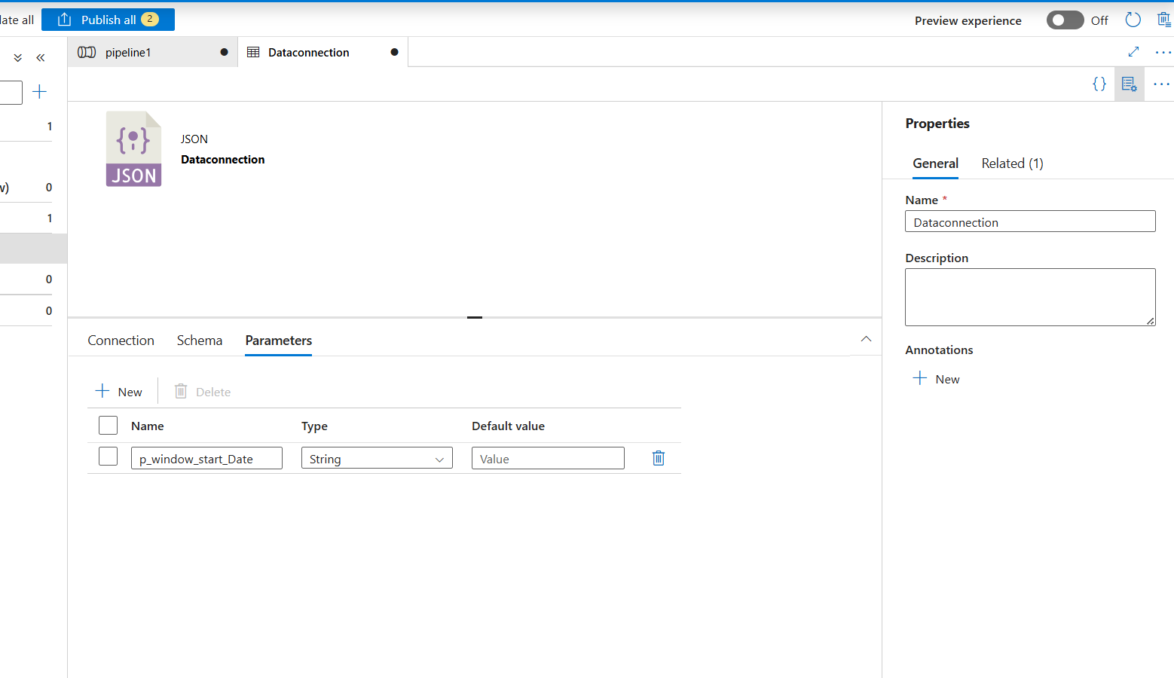
Setting the parameter for data connection

Slide 37
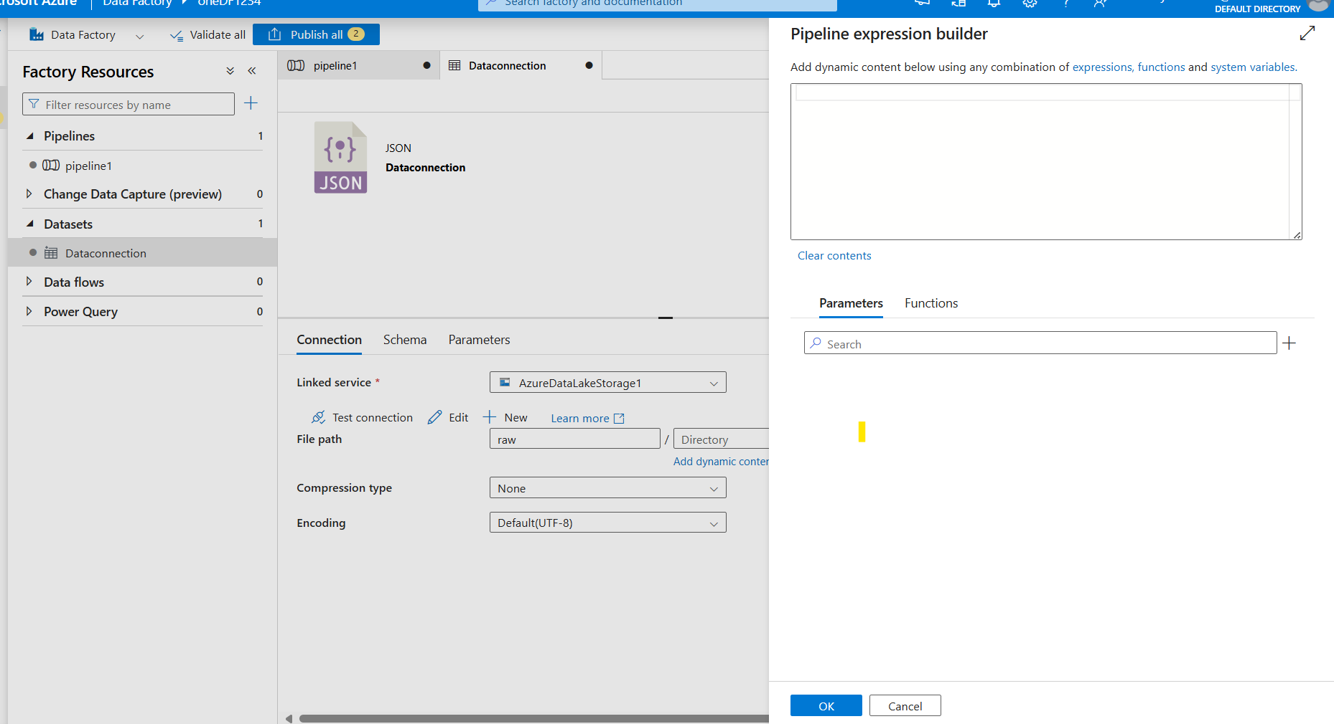
Connect the Storage
Pass the proper folder name.
So inside the raw we are having multiple folders and these can be dynamic.
Hence we should not hard code the folder name.
Now browse the folder raw and to add dynamic folder name select the Open this dataset from advance option.
From directory click on add dynamic content
Here date parameter need to be added.

Slide 38
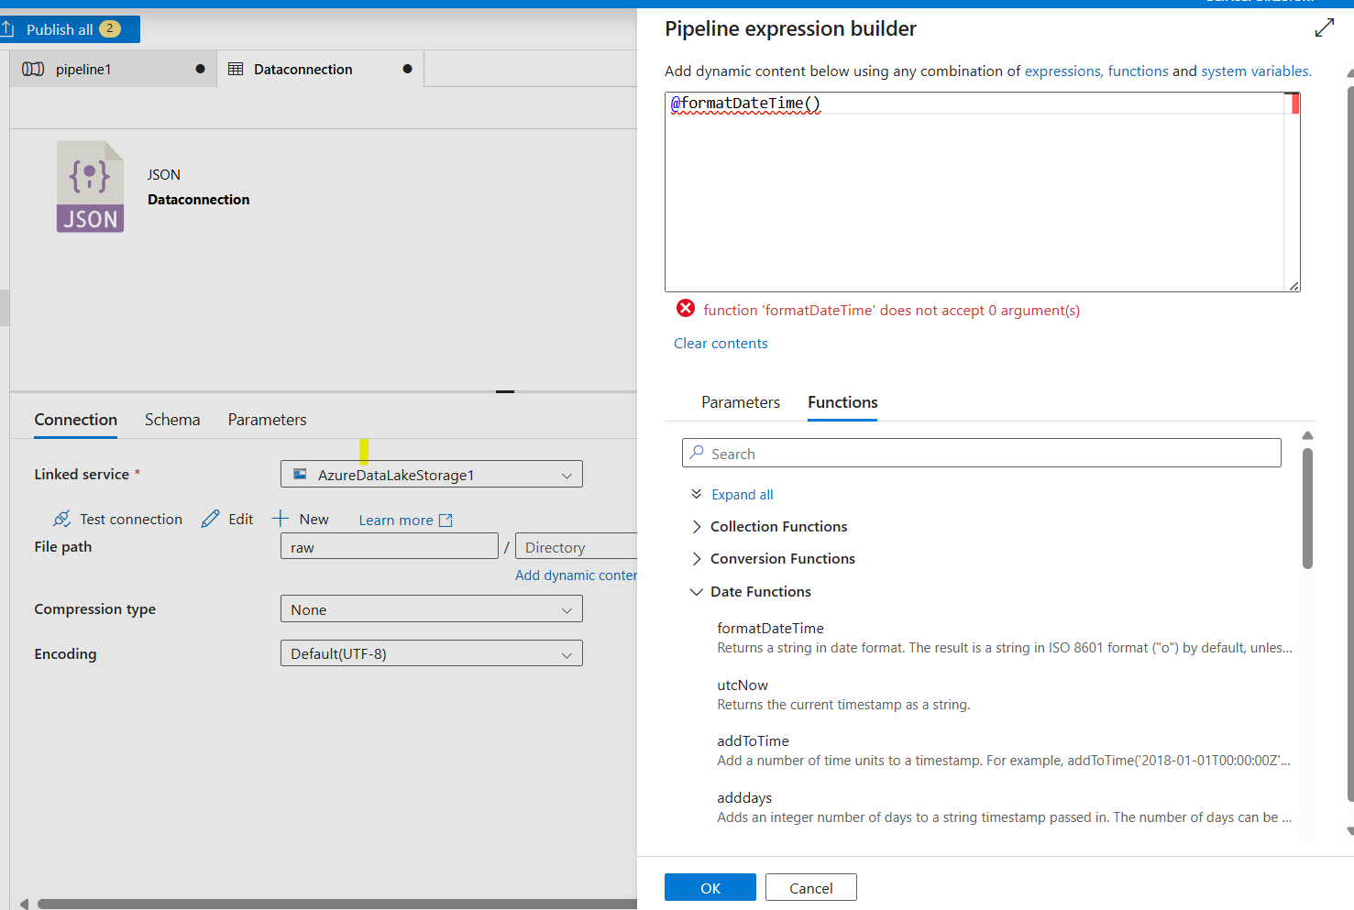
Connect the storage account
Click on the Add dynamic content
Go to function as input parameter is in date/ timestamp format
Select formatDateTime() and pass the parameter with date format.

Slide 39
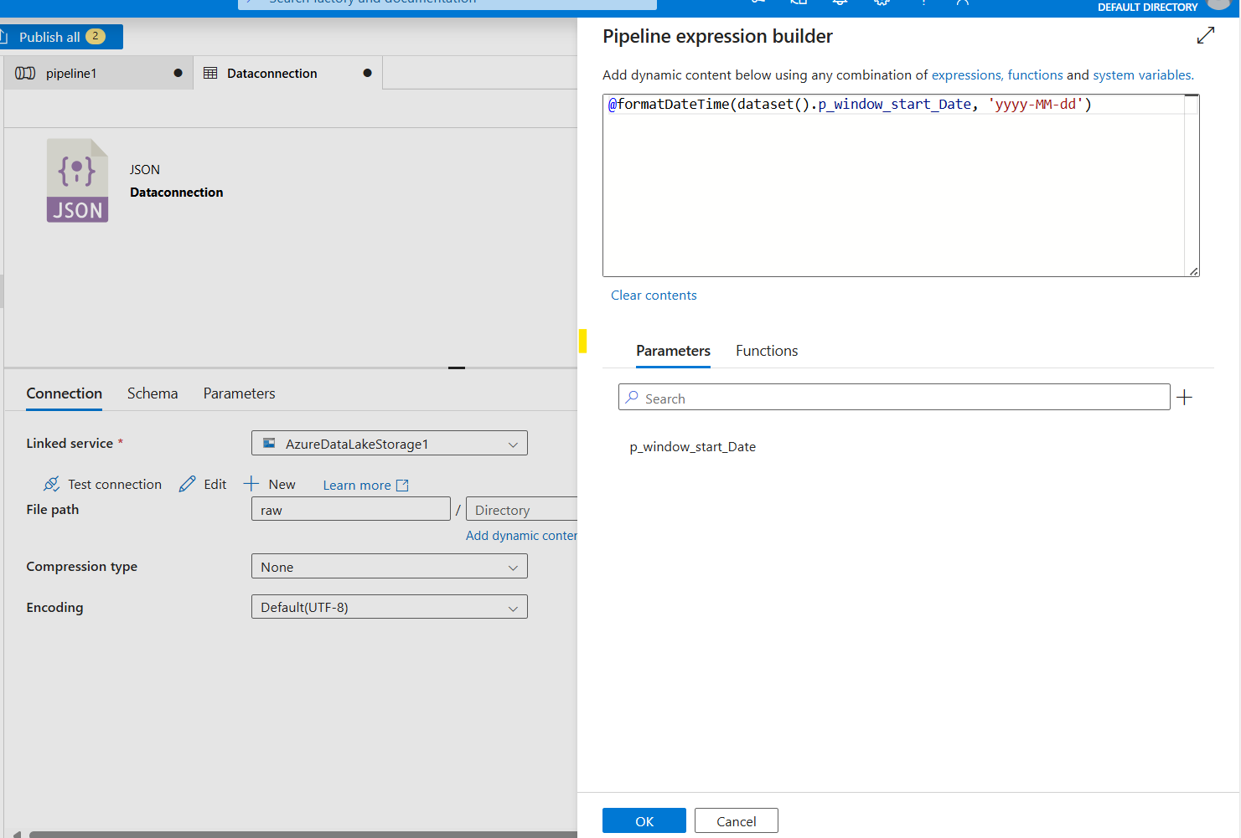

Slide 40
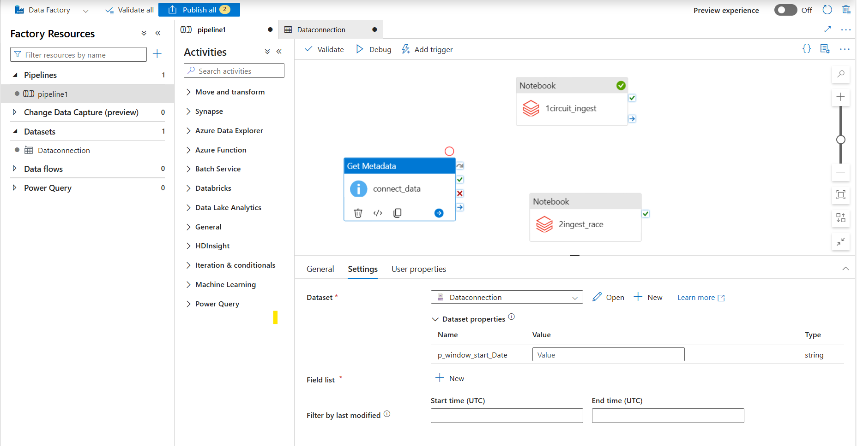
Go back to pipeline

Slide 41
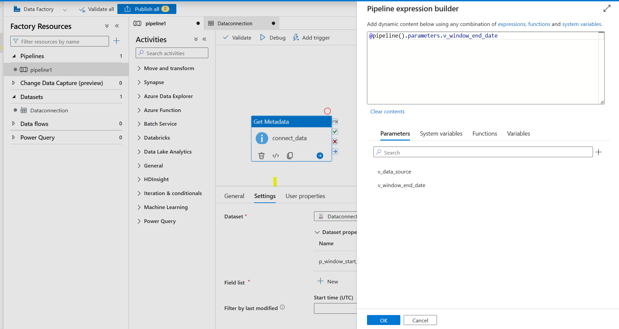

Slide 42
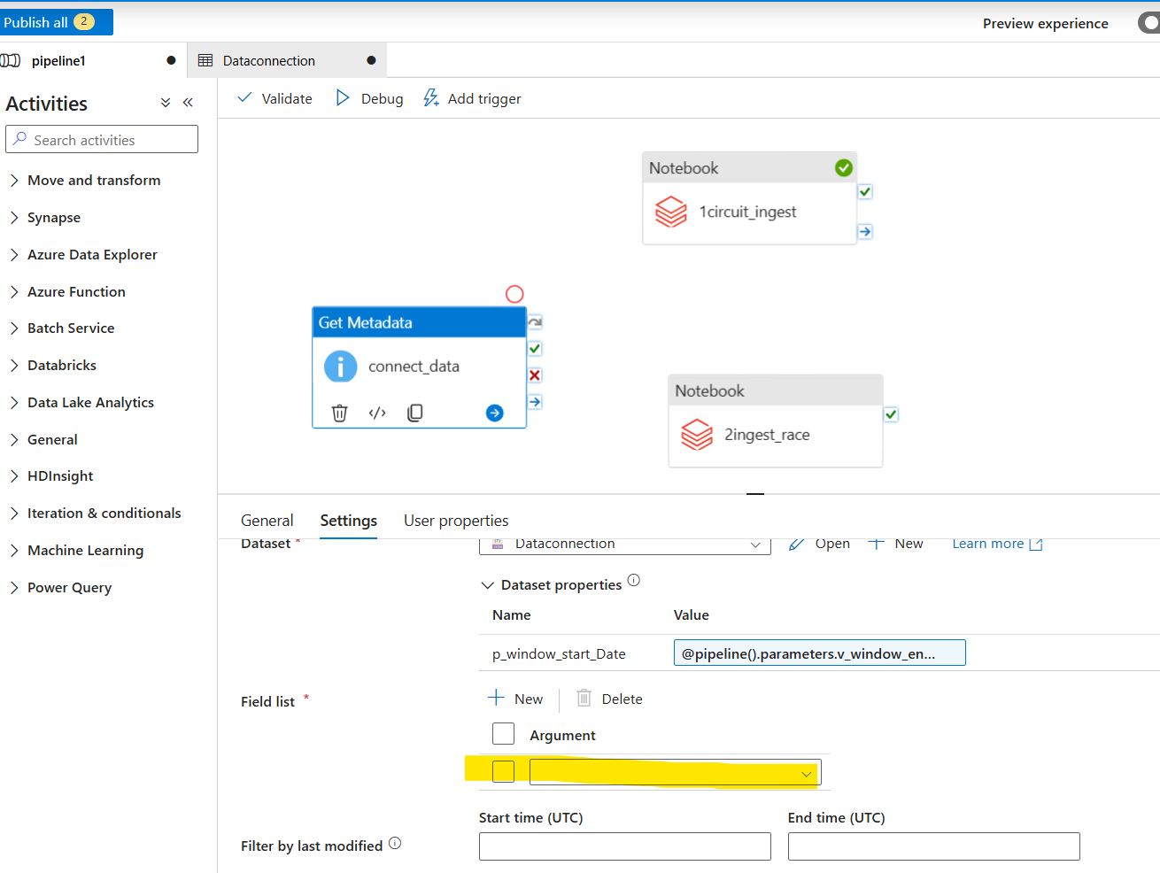
Field list
For the field list select Exists from the drop down options.
Drop down options are:
Child item
Exists
Item name
Item type
Last modified

Slide 43
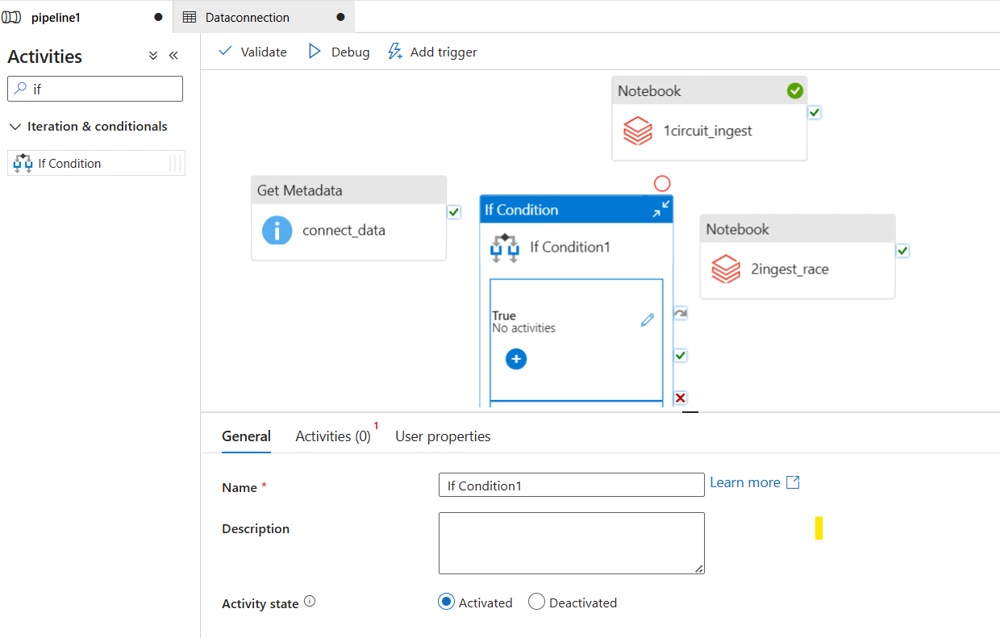
IF condition
To check if the data is really exists or not add new activity

Slide 44
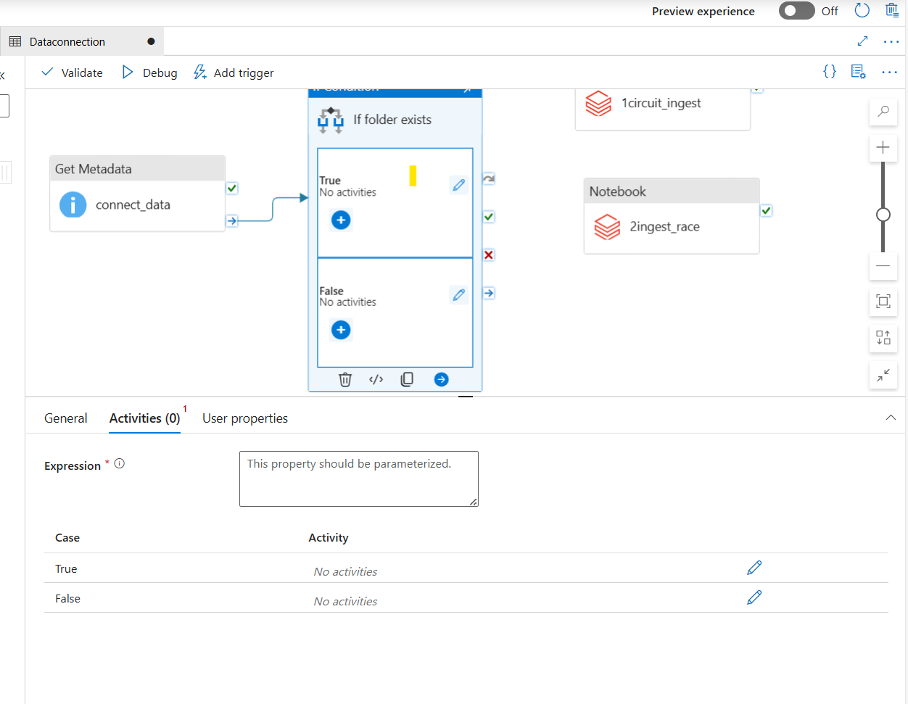
IF condition
Connect the data
Activities return either True or False
Next slide will add the dynamic values for expression.
Select Activity Outputs -> connect_data exists

Slide 45
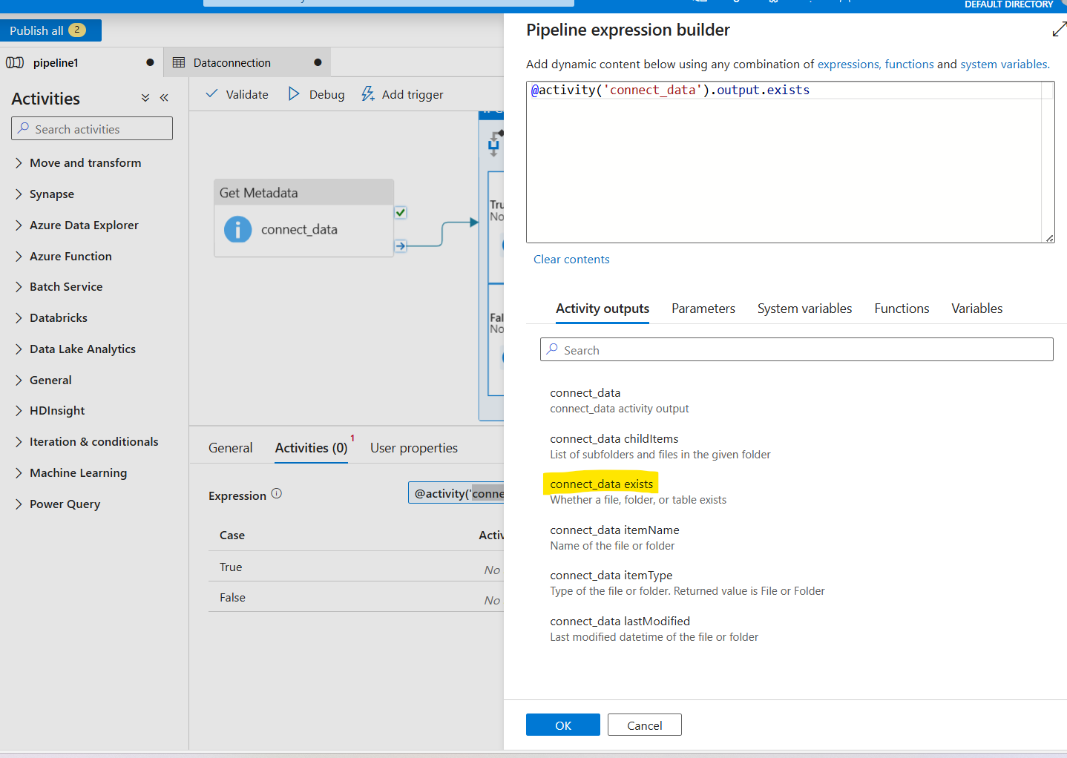
Check is folder exists
Once the connection check then define steps for True and False

Slide 46
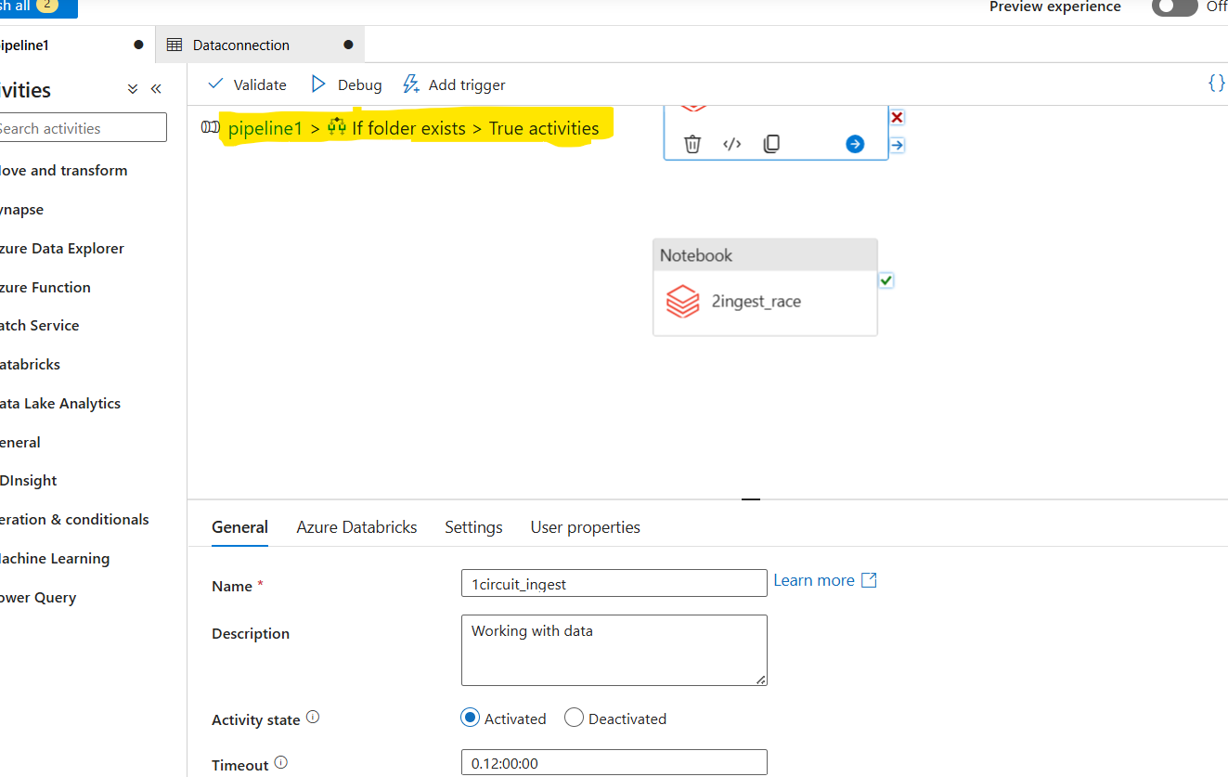
Edit the True condition
Edit the True
Cut all files from previous pipeline and add the same in True condition.

Slide 47
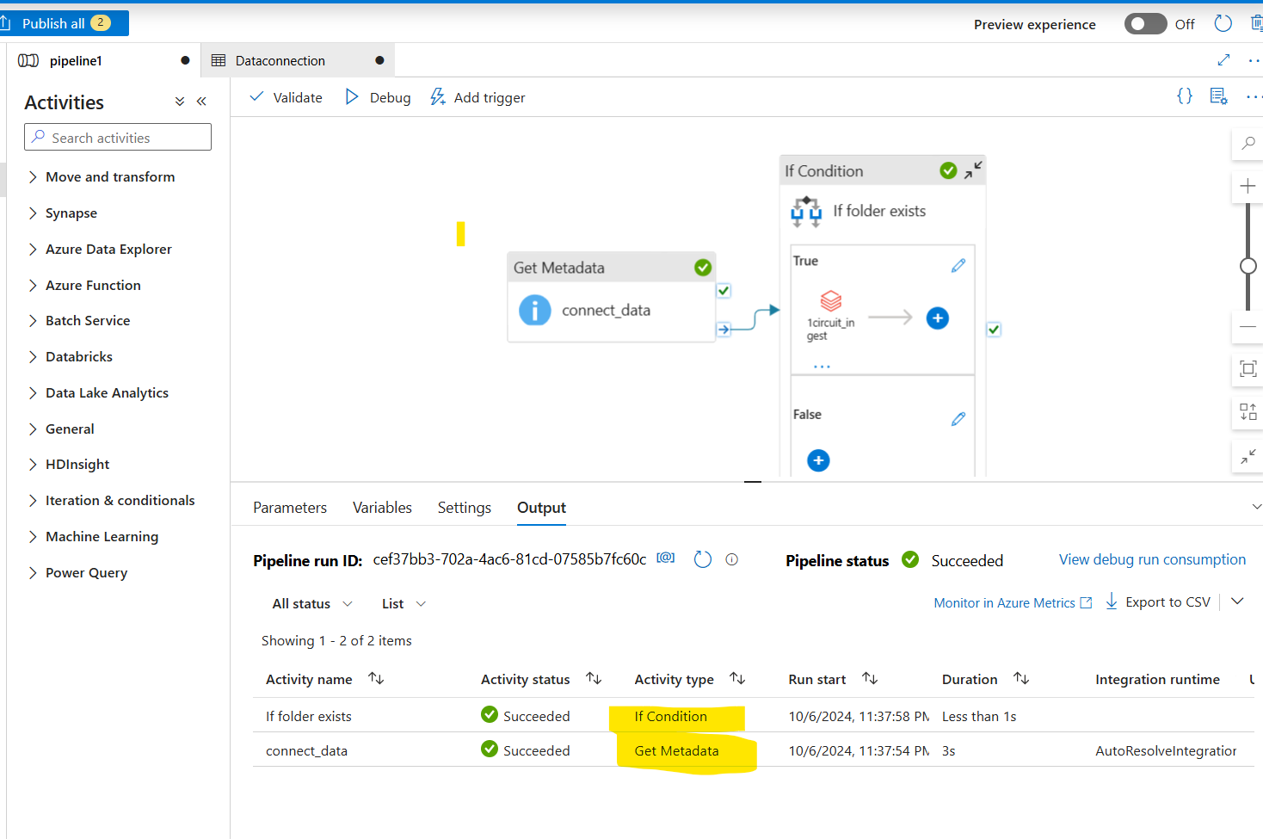
Debug
Pass the wrong data and see the result.

Slide 48
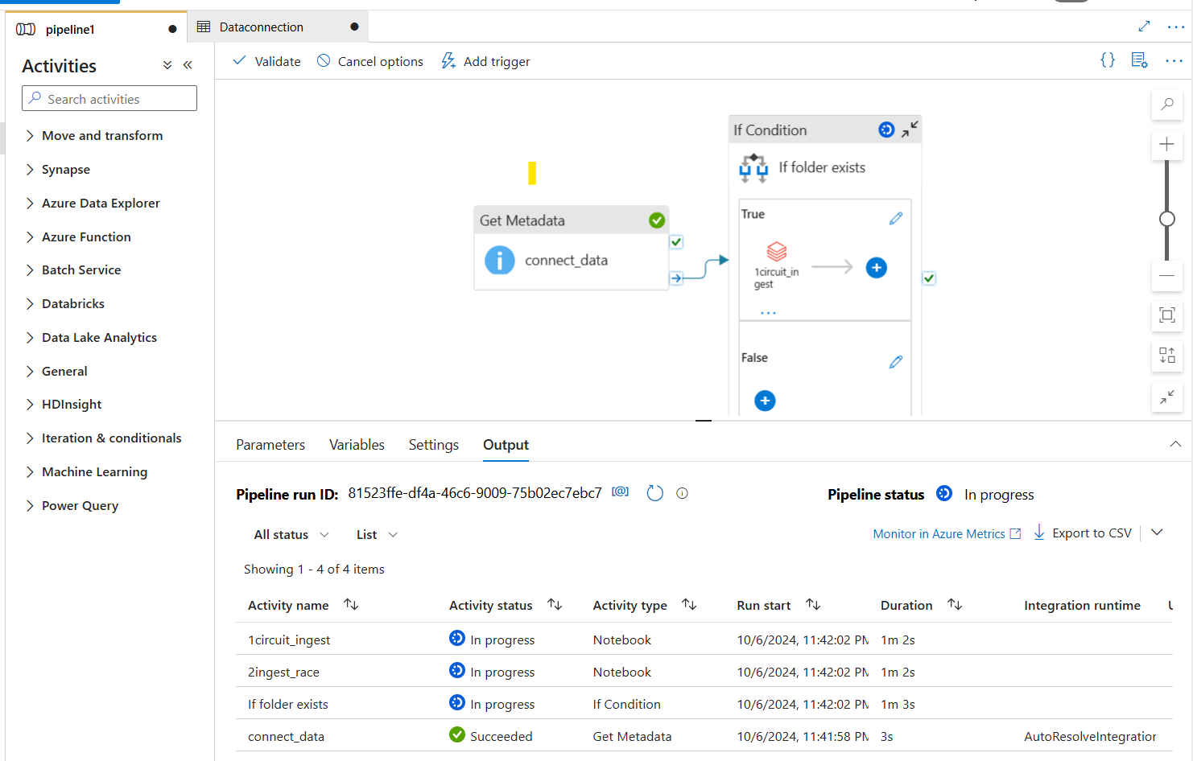
Debugs with correct date

Slide 49
Adding databricks using managed identity
Till the last slide we worked on accessing the databricks using access key.
Now we will connect using managed identity.

Slide 50
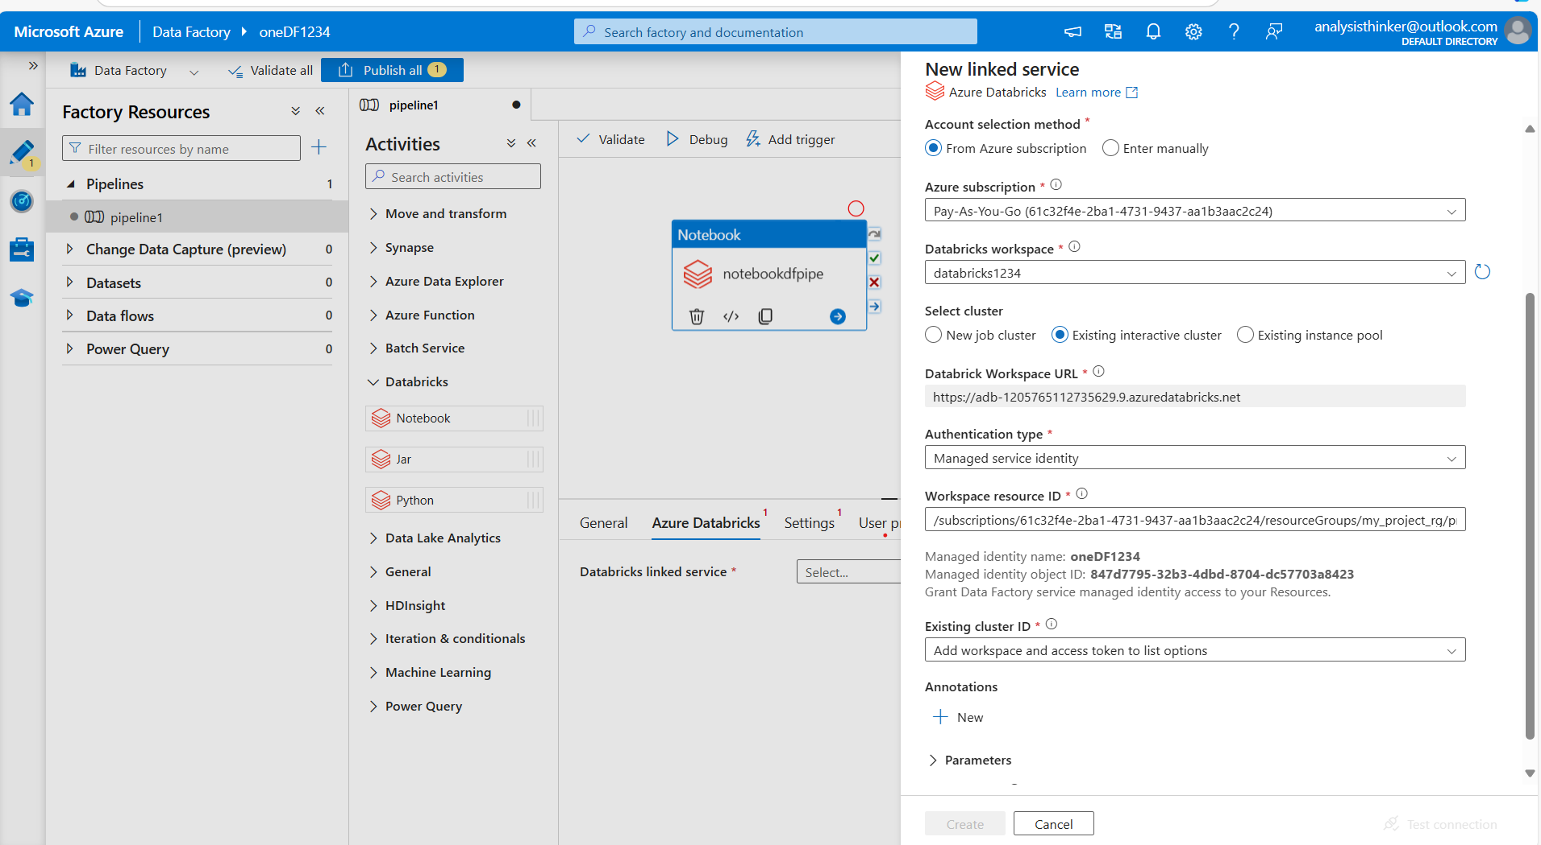
Connecting Databricks notebook to Data factory step-1

Slide 51
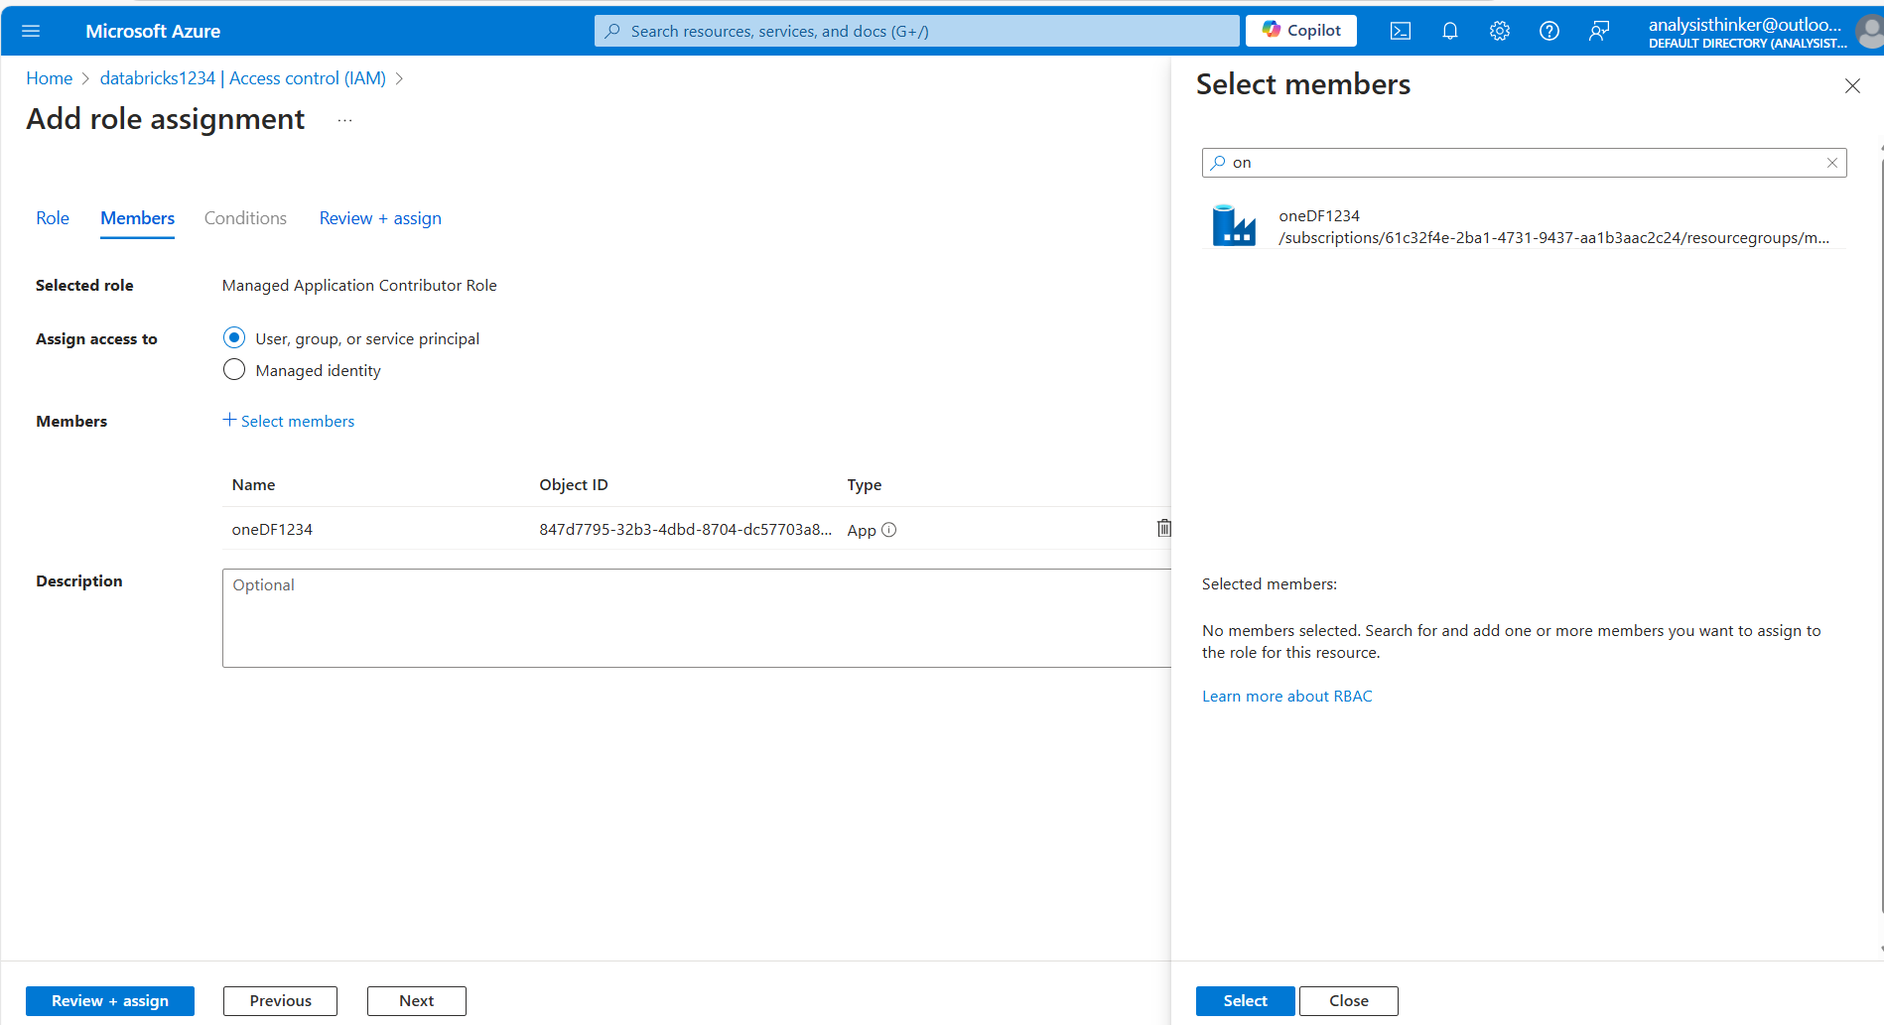
step2
Go to data bricks
Select IAM
Assign new role assignment
Select the contributor
Select member as Databricks member

Slide 52
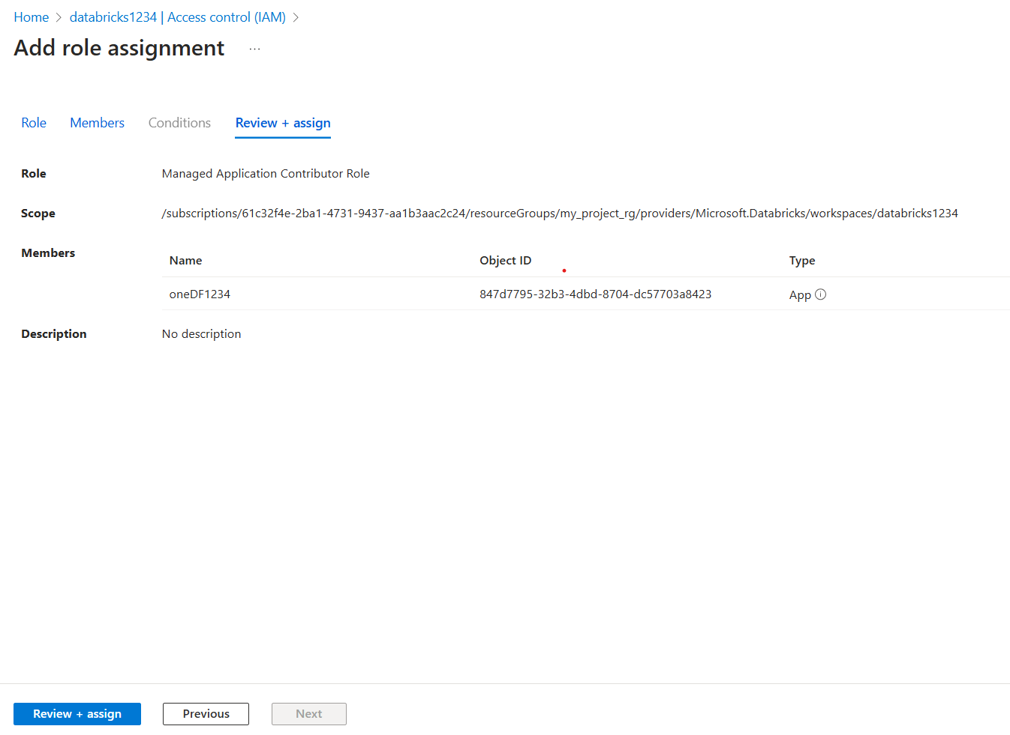
Step-3
Refresh the data bricks page and pass the cluster details.
Test the connection.

Slide 53
Thank You

